Slide 1
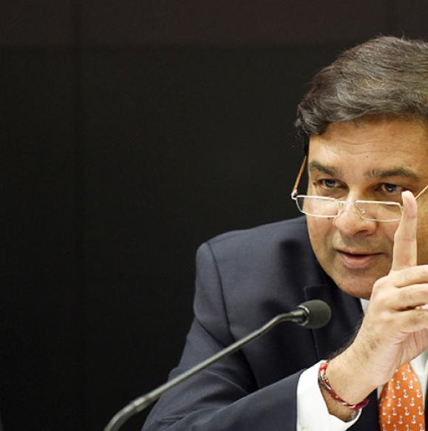
Monetary Policy: Tools
Quantitative/Gen./Indirect
Qualitative: Selective, Direct
Ratios: SLR, CRR & Incremental CRR
Margin / LTV
OMO & MSS
Rates: Bank, MSF, LAF [Repo, RR]
Consumer Credit control / EMI
Credit Rationing /PSL
Moral Suasion
Direct Action
Review of last one year’s policies

Slide 2
Balance sheet of a Scheduled commercial Bank
Liabilities
Assets
Demand liabilities
Loans
Time liabilities
SLR
Other liabilities
CRR
NDTL
4% CRR
20.5% SLR
40% PSL
Fixed assets, share capital, debentures…?
Let’s not confuse with info. overload
Notes:
Bad loans = non-performing assets

Slide 3


Bank’s Balance sheet-> Liabilities
Time liability
Demand
FD, cash certificates, Cumulative/ recurring deposits, Staff security deposit.
CA, Savings, demand draft
Overdue balance in FD
Unclaimed deposits
Other
Interest accrued on deposit
Unpaid dividends
Gold borrowed…..
Legally not required to pay before maturity (but minus penalty/less interest).
Latest 2015: “unbreakable FD”- can’t be redeemed before time, hv2 pay more interest.
Notes:
Minimum deposit Rs.1000/- and thereafter in multiples of Rs.100/- Period of deposit ranges from 6 months to 10 years in completed quarters. Interest compounded every quarter. Senior Citizens & Staff will be eligible for additional Rate of interest as per applicable norms. Premature withdrawal of the deposit is permitted any time on payment of the prescribed penalty. Loans upto a maximum of 95% of the balance available depending on the length of the unexpired period of the deposit. Nomination facility available. The rates of interest are as fixed by the Bank from time to time.

Slide 4



Net demand and time liability (NDTL) on FRIDAY..
+70
+60
Withdrawn
-20
-10
NET left
+50
Liabilities
Demand
Time
Deposit
+50
=+100
NDTL

Slide 5


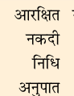


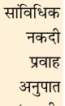
Ratios: to protect against bank “runs”
Time: FDRD
▼reserve =▲ Rs. To lend
NDTL (100 Crore)
Demand: CASADD
CRR
4%
SLR
20.50% (31/3/17)
Cash, Gold
RBI approved securities (G-sec,T-bill, PSU-debenture..)
Can’t lend
No profit
For scheduled banks: RBI Act Section 42/1.
Non scheduled, cooperative banks: Banking regulation act Section 18 & 56
Banking Regulation Act
Section 24/2A

Slide 6
Mock question for Prelims
Survey-14; V1c5
Assertion (A): Under SLR norms, RBI requires banks to hold a certain share of their resources in liquid assets such as cash, government bonds and gold.
Reason (R): SLR performs a prudential role during unexpected demand from depositors by quickly liquidating these assets.
Both right, R explains A

Slide 7
CRR/SLR maintained @Fortnight lag
Fortnight
Fortnight
Friday
NDTL
100 Cr.
Friday
Friday
4 cr. CRR
20.5 cr. SLR
Daily maintenance 90%
Notes:
Sunday sunday

Slide 8






Reserve Ratios
“Spread”
Pay 0-4-7%
Pay 10-15-18%
Depositors
Borrowers
CRR: 04%
SLR: 20.5%
Total: ~25%
CRR: 15%
SLR: 38%
Total: 53%

Slide 9
High reserve ratios (53%)
Pre-LPG
High cost of credit (loans)
Business expansion ▼
Exports ▼
Job creation ▼
Tax-Collection ▼
Government borrowing: Fiscal deficit ▲
Current Account Deficit ▲

Slide 10

1991: Narsimhan-i
Reduce CRR SLR
CRR-15%, SLR-38.5%
CRR: 4%; SLR: 20.5%
Narsimhan
Before
After

Slide 11
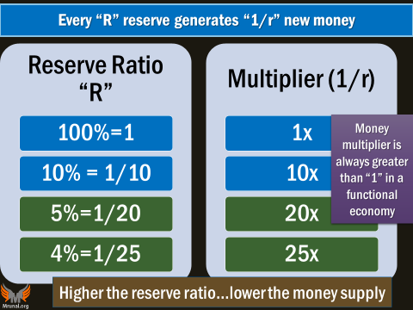
CRR in India
Earlier RBI Act had
ceiling 20%
floor 3%,
But removed in 2007
Among these, which rate will give highest Money Supply “M1”?

Slide 12
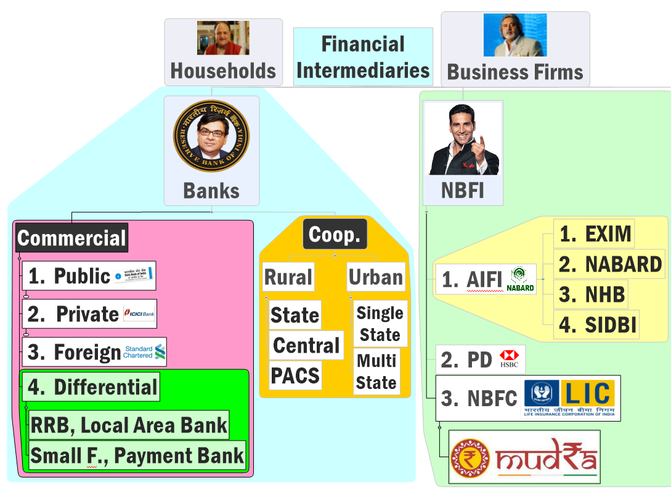


SLR applicable upto
Central cooperatives
And housing finance NBFCs.
RBI can prescribe separate levels for each.
NBFC-deposit taking

Slide 13
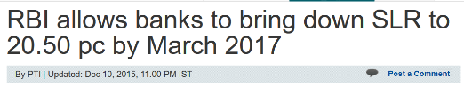
SLR – applicable up to central cooperative & deposit taking NBFC
Banking regulation Act
SLR Floor “25%” removed in 2007
SLR for Scheduled commercial banks

Slide 14


Monetary Policy: Quantitative, General, indirect Tools
Combat
CRR/SLR
▼
Inflation
Deflation
Policy?
Tight / Dear
Easy / Cheap
▲
Policy Rate (Repo)
OMO|MSS*
Money Supply
Decrease
Increase

Slide 15
UPSC Prelim-2015
When RBI reduces the Statutory Liquidity Ratio by 50 basis points, what will happen?
India's GDP growth rate increases drastically
FII may bring more capital into our country
It may drastically reduce the liquidity to the banking system
Scheduled Commercial Banks (SCB) may cut their lending rates
If “MUST” used then this statement will also be wrong.

Slide 16
Mock Question
A) Informal lenders reduce the efficacy of monetary policy.
R) Informal lenders are not required to maintain CRR & SLR.
-----------
Both right and R explains A. [they have not mentioned can’t borrow from Repo…Baal ki khaal…X]
Ability to bring desired effect.

Slide 17

Incremental CRR?

Slide 18
Net demand and time liability (NDTL) on FRIDAY..
+70
+60
Withdrawn
-20
-10
NET left
+50
Liabilities
Demand
Time
Deposit
+50
=+100
NDTL

Slide 19
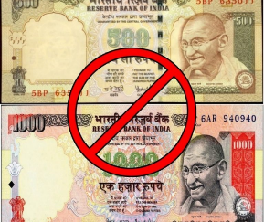
8/Nov/16: Demonetization….
+++
Withdrawal
- ceiling
- ceiling
NDTL
500
Liabilities
Time
Demand
Deposit
+++
500
=1000
Notes:
Tuesday
Yes there is FEMA
Excess liquidity …
Dirt cheap loans= personal loans for speculative investment. Exchange rates.
G-Sec: govt doesn’t have..
Gold beyond SLR: trade deficit

Slide 20



SLR Raise [20%->40%]
CRR raise (4%-40%)
Banks make losses (SA/FD)
Sufficient G-Sec …?
Gold…CAD
De monetization
Excess NDTL
Lending Rates ▼
Personal loans -> speculative investment; gold-diamond: CAD
foreign outflow exchange rate problems
By Demonetization
So have to curb loanable funds it..but how
Do something like this…until new G-sec can be issued (MSS)
Cash, Gold
RBI approved securities (G-sec,T-bill) but not oil bonds, Ferti bonds etc.
Can’t lend
No profit

Slide 21
why not “absolute” CRR?
Friday NDTL
Demonetization fortnight
CRR
100% absolute.
impact
Economy standstill
So keep 4%

Slide 22
CRR/SLR maintained @Fortnight lag
16/sept to 11/Nov
NDTL
400 cr.
Afterwards, absorbed through Market stabilization scheme (MSS)
Fortnight
Fortnight
Demon..
Friday
NDTL
1000 Cr.
Friday
Friday
40 cr. CRR
400 CR. CRR FOR 26/NOV TO 10/DEC
Incremental 100% CRR
Effectively 44% CRR..(hypothetical)
Notes:
Sunday Sunday
Difficult to project how much would return, hence older dates?

Slide 23
Monetary Policy: Tools
Quantitative/Gen./Indirect
Qualitative: Selective, Direct
Ratios: SLR, CRR, incremental CRR
Margin / LTV
OMO & MSS
Rates: Bank, MSF, LAF [Repo, RR]
Consumer Credit control / EMI
Credit Rationing /PSL
Moral Suasion
Direct Action
Review of last one year’s policies
NEXT

Slide 24
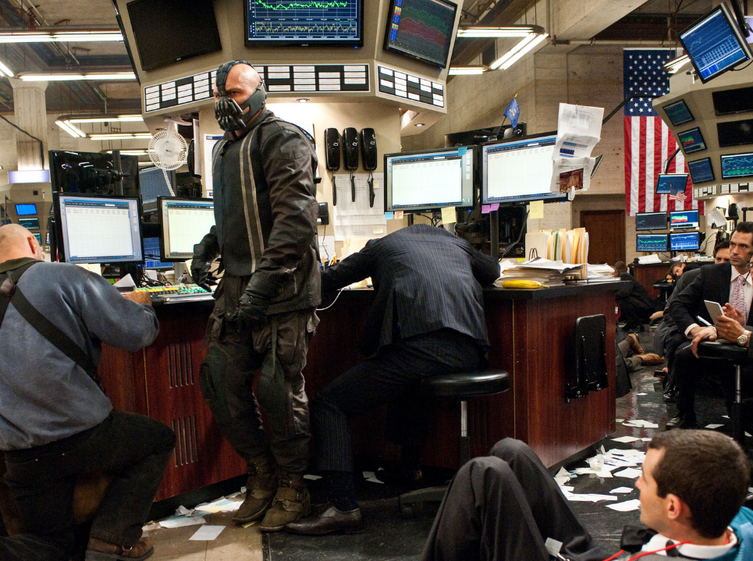
Open Market Operations (OMO) Market Stabilization Scheme (MSS)

Slide 25


Before we dwell into OMO, Market stabilization scheme…
Financial Market
Money Market
Capital Market
Primary
Secondary
Short term upto1 year
Long term >1 year
Govt: T-Bill, CMB,
Firm: C-Paper, P-notes
Govt: G-Sec, sovereign bonds
Firm: IPO, share, bond (=debentures)
Securities resold here

Slide 26

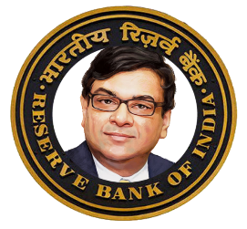




RBI: public debt manager, auctions on behalf of Government
100 Cr. @10% for
1 year
70 cr.
10 cr.
20 cr.

Slide 27

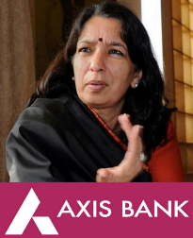
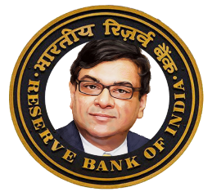
Open Market Operation in inflation
70 cr. G-sec
M1 : 30 cr.
To combat inflation, RBI has to reduce money supply

Slide 28
Open Market Operation in inflation
M1 : 30 cr.
M1: 20 cr.
To combat inflation, RBI has to reduce money supply

Slide 29
Why would banks bother with OMO?
Pay 0-4-7%
Pay 10-15-18%
Depositors
Borrowers
Idle money
=LOSS MAKING
Must invest
G-Sec: 8%
At least 1% “spread”

Slide 30
RBI’s Monetary policy-> quantitative tools
Combat
CRR/SLR
▼
OMO
Sell G-sec
Inflation
Deflation
Money?
Tight / Dear
Easy / Cheap
▲
Buy
Money Supply
Decrease
Increase

Slide 31
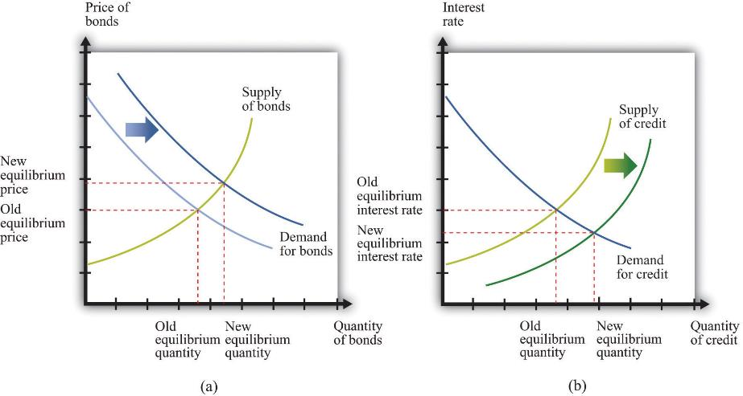

Slide 32
Open Market Operations (OMO) Market Stabilization Scheme (MSS)

Slide 33

RBI: public debt manager, auctions G-sec on behalf of Government
100 Cr. @10% for
1 year
70 cr.
10 cr.
20 cr.

Slide 34

Suppose Government doesn’t want to “borrow” to buy something, but RBI needs “securities” to control liquidity…THEN??
100 Cr. @10%
after 1 year upon maturity
70 cr.
77 cr
10
11 cr.
20 cr.
22 cr.

Slide 35
This had actually happened….!!
2003: volatility in dollar exchange rate….RBI bought dollars-> rupees; Rupee supply ▲
RBI sold G-Sec to banks to decrease rupee supply.
Ultimately RBI left without sufficient G-sec for future liquidity management!
2004: MoU with Government

Slide 36
Market stabilization scheme bonds: not for govt Expenditure
upto 2 years maturity G-sec;
upto 364 days T-bill;
upto 90 days maturity Cash management bill (CMB)
Government doesn’t use this money to meet Expenditure, but pays “interest”
Ceiling: Rs. 30k cr
10 cr.
11 cr
20 cr.
22 cr.

Slide 37

Sell at discount and re-purchase at “FACE Value”.
A t-shirt has Printed-price of Rs. 110/- If I sell you with a discount of 10 Rupees and re-purchase it Printed Price after 364 days, what is your profit percentage?
$$=\frac{Profit (110−100)}{Investment (100)}=\frac{10}{100}=10\%$$

Slide 38

Sell at discount and re-purchase at “FACE Value”.
A T-bill or cash management bill (CMB) with face value Rs. 100/- is sold with a discount of 7 Rupees and re-purchased at face value on maturity. Calculate interest rate?
$$=\frac{profit or Interest (100−93)}{Investment (93)}=\frac{7}{93}=7.5\%$$

Slide 39
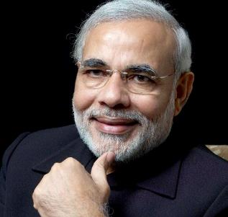
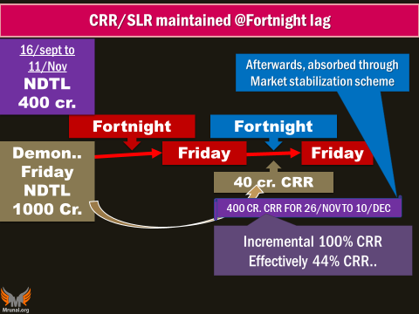
MSS- T-bill, cash management bill: sold @discount & repurchased at face value on maturity
Government doesn’t use this money to meet Expenditure, but pays “interest”
Face value: 100
Sold @ Rs.93
….
Ceiling: 30k cr.
Dem: ceiling raised to 6 lakh Cr.
22 cr.
20 cr
SBI’s Profit: 7 / 93 =~7.5%

Slide 40
Cash management Bills (CMB):
Otherwise
Started in 2009, Generic character of treasury bills (T-Bills)
Sold at discount through bidding on e-kuber. T+1 settlement; Eligible as SLR.
Maturity upto 90 days (<91 days)
Demonetization;
MSS ceiling increased to 6L cr
28 Days CMB: 20k cr,
35 days CMB: 60k cr.;.
When 100% incremental CRR removed. (10/dec/16), excess liquidity absorbed via MSS-CMB
Notes:
CMBs tend to pay higher yields than bills with fixed maturities, but their shorter maturities lead to lower overall interest expense.

Slide 41
OMO vs MSS: What’s the Difference?
Type
Purpose
Mainly to Reduce liquidity
OMO
MSS
Expand/reduce liquidity
Govt
Part of Borrowing program
Not, but still pays interest.
RBI’s profit (from other “ASSETS” like Repo loans, US T-bonds)-> profit -> dividend to Govt. so Government is not ‘making losses’ per se.
Notes:
જે પ્રિસ્થિતિઓ માં એણે રજુ કરેલા ૨૦૦૩-૦૪ માં એ મુજબ liquitiy expansion doesn’t seem to be the primary objective .

Slide 42
RBI’s monetary policy
Combat
CRR/SLR
▼
OMO
Sell
Inflation
Deflation
Money?
Tight / Dear
Easy / Cheap
▲
Buy
MSS
Sell
NA?
Money supply
Decrease
Increase
Because primarily they are issued to absorb excess liquidity

Slide 43
Mock Question
Market stabilization scheme (MSS) correct statements?
MSS securities are issued to provide RBI with a stock of securities for liquidity management.
MSS securities are not issued to meet government’s expenditure.
Government pays “interest” on MSS bonds
All correct.

Slide 44
Monetary Policy: Tools
Quantitative/Gen./Indirect
Qualitative: Selective, Direct
Ratios: SLR, CRR & Incremental CRR
Margin / LTV
OMO & MSS
Rates: Bank, MSF, LAF [Repo, RR]
Consumer Credit control / EMI
Credit Rationing /PSL
Moral Suasion
Direct Action
Review of last one year’s Monetary policies.
NEXT

